Slide 1
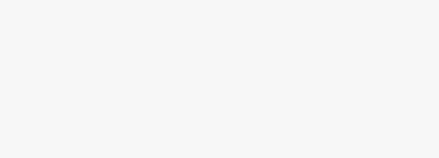



RASID : CCTV violence detection using computer vision.
Team member :
Rahaf Alatiq
Sahar Yatimi
Instructor:
Patrick

Slide 2
Table of contents :
01 Objectives
02
Dataset
03
Methods
04
Results
05
Future Work

Slide 3
1.Objectives :
The current CCTV system lacks the ability to detect violent behaviours, so we decided to add AI to increase CCTV systems effectiveness in detecting violence and identifying those who have committed it.

Slide 4
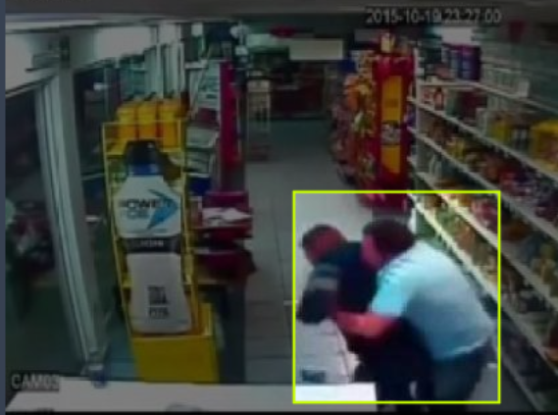
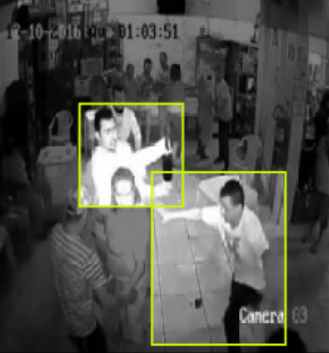
2. Dataset
We obtained a dataset from “Roboflow” containing over 3000 annotated image with bounding boxes around violent acts and labels indicating the perpetrators.
Split the dataset into :
Train Set
80 %
Valid Set
10 %
Test Set
10 %

Slide 5
3.Methods :
The previous research utilized low-accuracy models and low-quality datasets for detecting violence and their approach relied on basic classification which only identified the presence of violence without localizing it.
We will take a different approach by leveraging recent advances in object detection to identify the location of violence.
This rich annotation allows us to train state-of-the-art object detection models like YOLOv8 and ssd-mobilenet-v2.

Slide 6
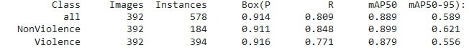
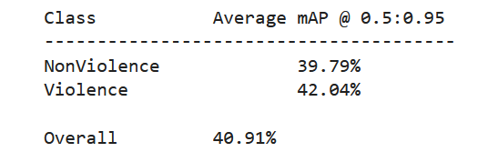
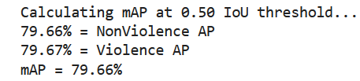
4.Results :
YOYLv8 model :
SSD-Mobilenetv2 model :

Slide 7



5.Future Work :
RASID in the future :
Connect
Expansion
Sending alerts

Slide 8
THANK YOU FOR LISTEING.

